Slide 1
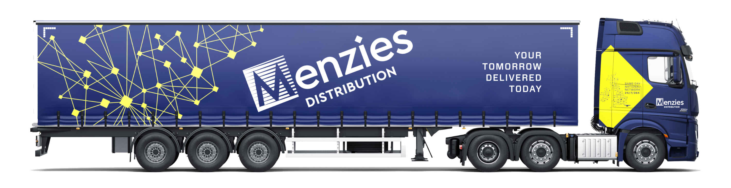
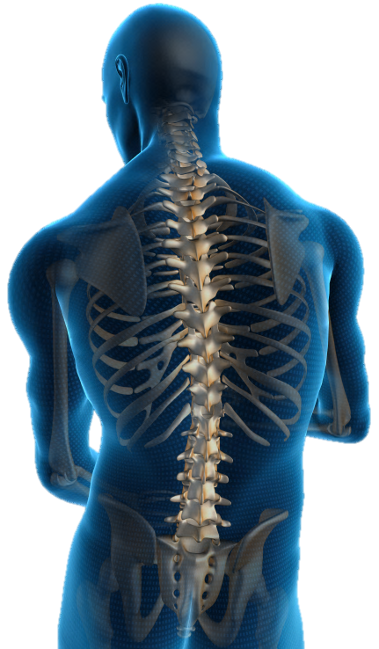
Manual Handling
Training for handlers
PRESENTATION FOR DRIVERS
Revision 1.10 – 18/Jan/2022
Notes:
1
The purpose of this session is to reduce and to help prevent musculoskeletal ill-heath amongst your employees.
Most, if not all your delegates, know what the safer handling and seated posture is. They also know that it if we use safer techniques, we may prevent an injury in the future. However, very few people adopt good posture to prevent an injury, they tend to use good posture because they have suffered an injury.
This session will make your delegates think about all of the reasons why people adopt compromised postures in day to day life, and make them appreciate all of the benefits if they do undertake safer handling techniques.
Ice Breaker: Allow the delegates 2-3 minutes to think of 5-10 things that they enjoy doing in their lives. Using your white board, ask the group to call out some of the items on their list. You should collate a list of at least 15-20 items. These often include the following:
Socialising
Spending time with family and friends
Playing sports
Holidays
Money
Sleeping
Music
Watching Films
Meals out etc.
Now ask the group: “How many of these activities can be done with a chronic injury?” Ask the group how they would feel if their life was so restricted and who would be affected by this.
Menzies (formally Bibby) Trainer Support Pack PowerPoint
-----------------------------------------------------------------------------------------------------------
Revision 1.07 – 06/Feb/2020
Revision 1.08 – 23/Nov/2020 – Updated injury statistics. Changed slide size to ‘wide-screen’ format.
Revision 1.09 – 20/Apr/2021 – Rebranding from Bibby to Menzies.
Revision 1.10 - 18/Jan/2022 - Further interim rebranding of slides from Bibby to Menzies, including videos.

Slide 2
Manual Handling - Definition
The transportation or supporting of a load (including lifting, putting down, pushing, pulling, carrying or moving) by hand or by bodily force.
The term ‘load’ includes objects, people and animals.
Manual Handling Operations Regulations 1992 (as amended)
Notes:
2
Ask your group which industries they think have the highest injury rates and why?
You can expand on the term load (objects, people and animals) this might help them.
People handling/caring professions traditionally have a very high injury rate. You could ask your group what they think has been done to try to reduce these injury rates? This section of industry has spent millions of pounds on handling equipment such as hoists, slide sheets, adjustable beds, etc. to make the job of a handler more ergonomic.

Slide 3
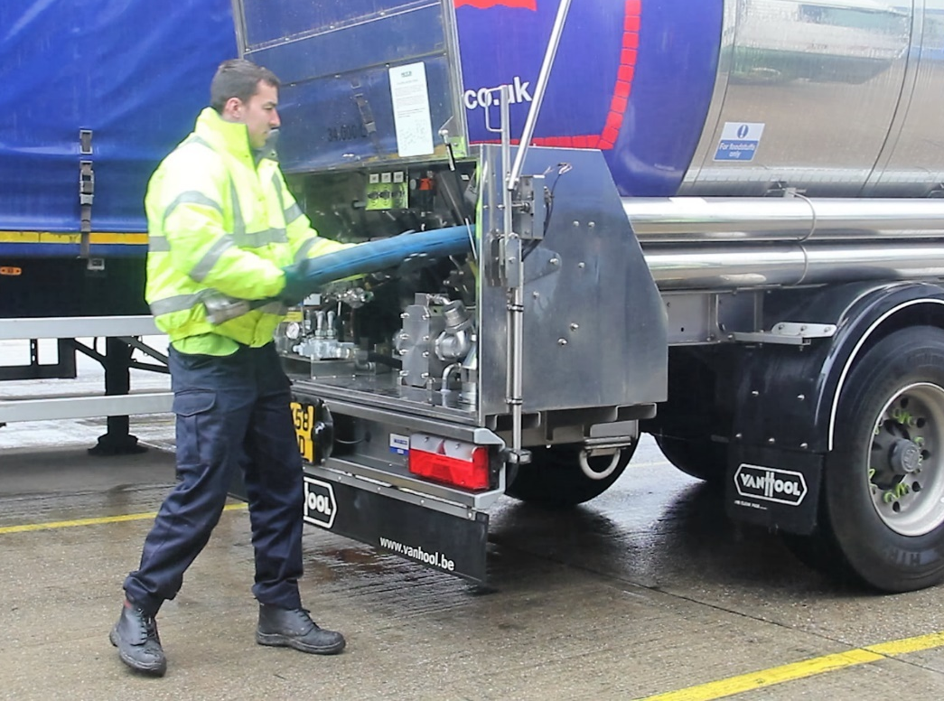
Manual Handling operations
Putting down
Carrying
Pulling
Pushing
Supporting
Picking up
Notes:
3
Expand on all the modalities of Manual Handling – putting down, pushing, pulling, carrying, supporting and picking up.
What is the most common modality in their job?
There are also positives associated with having a physical job, such as:
Strong muscles
Strong bones
Strong ligaments and tendons
Exercise (can help with weight control)
Cardiovascular benefits
Not just at work – its how we use our bodies every day
A question to these people could be, “How many manual handling tasks do you think you’ve already performed before arriving at work today?” Did they reach out of the shower to grab a towel, bend over to pick some clothes up off the floor, push the wheelie-bin to the end of the drive, or carry the recycling box outside? Chances are they’ve already performed dozens without even noticing.
Not just at work – its how we use our bodies every day
A question to these people could be, “How many manual handling tasks do you think you’ve already performed before arriving at work today?” Did they reach out of the shower to grab a towel, bend over to pick some clothes up off the floor, push the wheelie-bin to the end of the drive, or carry the recycling box outside? Chances are they’ve already performed dozens without even noticing.

Slide 4
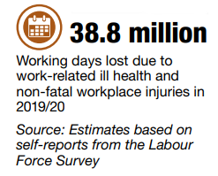
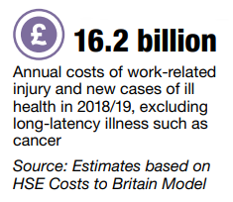
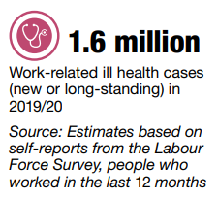
The ‘cost’ of workplace injury
Summary statistics for Great Britain
Most common causes of workplace injury
(non-fatal injuries, 2017-2020)
Source: Labour Force Survey (LFS) self-reported workplace non-fatal injuries, 2017/18 to 2019/20.
Notes:
Highlight prevalence of “Handling, lifting or carrying” injuries.
How much money could be saved if injuries were prevented?
How much additional productivity could be achieved if injuries were prevented?

Slide 5
Focus on musculoskeletal disorders
The total number of workers suffering from work-related musculoskeletal disorders in 2019/20 was 480,000 out of a total of 1.6 million for all reported new and long-standing cases of work-related ill health; this represents 30% of the total. [Note: Stress, depression, or anxiety account for 51% of the total.]
In 2019/20 an estimated 8.9 million working days were lost due to work-related musculoskeletal disorders. This equates to an average of 18.4 days lost per case, and this represents 27% of all working days lost due to work-related ill health.
[Source: Labour Force Survey.]
In any given month, about one third of the UK adult population will suffer from back pain. About 80% of the UK population will suffer significant back pain at some time in their lives. After coughs and colds, lower back pain is the most common reason for GP visits.
480,000
workers suffering from work-related
musculoskeletal disorders
(new or long-standing) in 2019/20
8.9 million
working days lost due to work-related
musculoskeletal disorders in 2019/20
Source: Labour Force Survey (LFS), self-report data, published 2020.
Notes:
5
This slide highlight the key Labour Force Survey and HSE stats related to MSD injuries.
Percentage of MSD injuries are high, but these are being gradually overtaken by “Stress, Depression or Anxiety”. This is an growing problem area.
Talk about link and relationship between body and mind.
MSD sufferers are more likely to suffer depression & stress. And when someone is depressed they are less likely to recover quickly.

Slide 6
Focus on musculoskeletal disorders
Source: Labour Force Survey (LFS) self-reports for period 2019/2020 (published 2020).
Source: Labour Force Survey (LFS) 3-year average 2009/10 – 2011/12 (The latest analysis available).
Notes:
Talk about the key figures/statistics.
Ask the group….
Are these figures what you would expect?
How do these stats reflect what you see in your business/job?

Slide 7
MHOR 1992 - Employers Duties
Employers are legally required to:
Avoid hazardous manual handling operations
Make suitable and sufficient assessment of risks
Reduce risk to lowest reasonably practicable level
Provide general info, or precise information where reasonably practicable, on the weight and distribution of the load.
Notes:
7
Talk about the responsibilities that EMPLOYERS have, in relation to Manual Handling operations.
Manual Handling Operations Regulations 1992.
What could be the consequences if an employer does not follow the rules (the law!)?
Some shocking stories relating to lawsuits.
1.) January 2000: Kathleen Robertson of Austin, Texas was awarded $780,000 by a jury of her peers after breaking her ankle tripping over a toddler who was running inside a furniture store.
The owners of the store were understandably surprised at the verdict, considering the misbehaving little snot was Mrs. Robertson's son.
2.) June 1998: A 19 year-old Carl Truman of Los Angeles won $74,000 and medical expenses when his neighbour ran over his hand with a Honda Accord. Mr. Truman apparently didn't notice there was someone at the wheel of the car when he was trying to steal his neighbour's hubcaps.
3.) October 1998: Terrence Dickson of Bristol, Pennsylvania was leaving a house he had just robbed by way of the garage. He was unable to get the garage door open since the automatic door opener was malfunctioning. He couldn't re-enter the house because the door connecting the house and the garage locked when he pulled it shut. The family was on vacation. Mr. Dickson found himself locked in the garage for eight days. He subsisted on a case of Pepsi he found and a bag of dog food. He sued the homeowner's insurance, claiming the situation caused him undue mental anguish.
The jury agreed to the tune of half a million dollars.
4.) October 1999: Jerry Williams of Little Rock was awarded $14,500 and medical expenses after being bitten on the buttocks by his next door neighbor's beagle. The beagle was on a chain in it's owner's fenced-in yard.
The award was less than sought because the jury felt the dog might have been just a little provoked at the time by Mr. Williams who was shooting it repeatedly with a pellet gun.
5.) May 2000: A Philadelphia restaurant was ordered to pay Amber Carson of Lancaster, PA $113,500 after she slipped on a soft drink and broke her coccyx. The beverage was on the floor because Ms. Carson threw it at her boyfriend 30 seconds earlier during an argument.
6.) December 1997: Kara Walton of Claymont, Delaware successfully sued the owner of a night club in a neighboring city when she fell from the bathroom window to the floor and knocked out her two front teeth.
This occurred while Ms. Walton was trying to sneak through the window in the ladies room to avoid paying the $3.50 cover charge. She was awarded $12,000 and dental expenses.
And the winner is:
7.) Mr. Merv Grazinski of Oklahoma City. In November 2000, Mr. Grazinski purchased a brand new 32 foot Winnebago motor home. On his first trip home, having joined the freeway, he set the cruise control at 70 mph and calmly left the drivers seat to go into the back and make himself a cup of coffee. Not surprisingly, the Winnie left the freeway, crashed and overturned. Mr. Grazinski sued Winnebago for not advising him in the handbook that he could not actually do this.
He was awarded $1,750,000 plus a new Winnebago. (Winnebago actually changed their handbooks on the back of this court case, just in case there are any other complete morons buying their vehicles.)

Slide 8
MHOR 1992 - Employees Duties
Employees are legally required to:
Take reasonable care of their own health and safety and that of their colleagues and clients.
Use available work and safety equipment, in accordance with the training and instruction provided.
Follow appropriate systems of work laid down by the employer in their manual handling policy.
Use proper channels to inform management of possible hazards or shortcomings in manual handling activities.
Notes:
Employees must realise that they have duties too.
They must follow the safe systems of work laid down in the employers MH policy
Expand on proper channels to inform management……..

Slide 9
Risk Assessment Filter
Image source: HSE Manual Handling Operations Regulations 1992
Notes:
The Risk Assessment Filter (from the Manual Handling Operations Regulations 1992)
Talk about how the weight of a handled object decreases as it moves further away from the body.
Talk about how the weight of a handled object decreases as it moves away from the ‘core’ of the body, i.e. down low or up high.
Ideally, you want the handled object to be close to you, and held close to your core i.e. waist/stomach.
Note: These weights/figures are not the law. These are just recommendations.

Slide 10
Pushing or Pulling Static Loads
The guidance suggests a starting force guideline of 20kg (200n) for the average male.
The guidance suggests a moving force guideline of 10kg (100n) for the average male.
There is a recommended distance guideline over which a load may be pushed without resting; that is 20 metres.
Notes:
This slide provides the recommended pushing or pulling loads guidance figures. These figures for stopping/starting a load and for keeping a load in motion are provided in the Health and Safety Executive guidance booklet L23 “Manual Handling Operations Regulations 1992 - Guidance on Regulations”. [ www.hse.gov.uk/pubns/books/l23.htm ]
Note: These weights/figures are not the law. These are just recommendations.

Slide 11
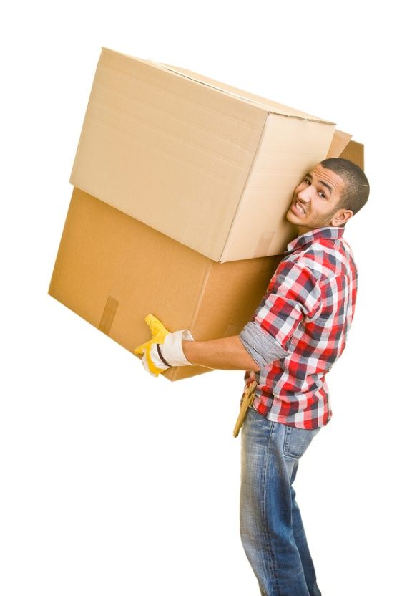
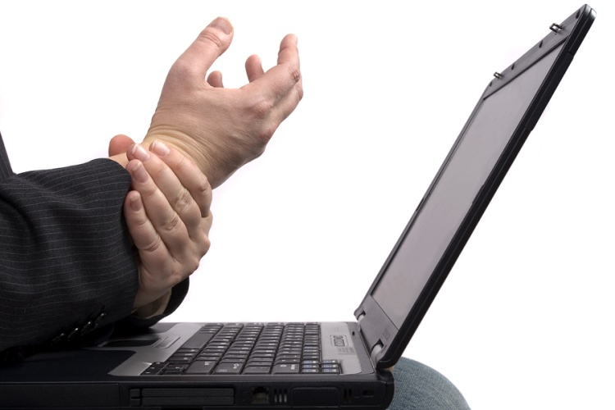
Mechanism of injury
Sudden Vs Cumulative
Sudden
Cumulative
Cumulative
Cumulative
Notes:
11
Ask the delegates which type of injury they think they would see most in their line of work (in in their business/company).
Cumulative strain is defined as the “progressive degeneration or stiffening of body and muscle tissue due to habitual excessive or prolonged exertion or loading”.
Over-exertion injuries tend to be more sudden in nature and are often caused by a one-off event.
Cumulative injuries can be built up over a long period of time.
Cumulative injuries could be from lifting very light-weight items repeatedly. I.e. picking from shelves. This will be made much worse if those items are low down or high up (i.e. stooping or reaching).
There is evidence to suggest that the majority of musculoskeletal disorders (MSDs) are due to an accumulation of actions rather than from any one single incident or event. The single action of a task may be relatively harmless e.g. loading cans onto a supermarket shelf for example. The cumulative effect of repeating this task over a long period of time - often weeks, months or years however may lead to a cumulative strain injury.

Slide 12
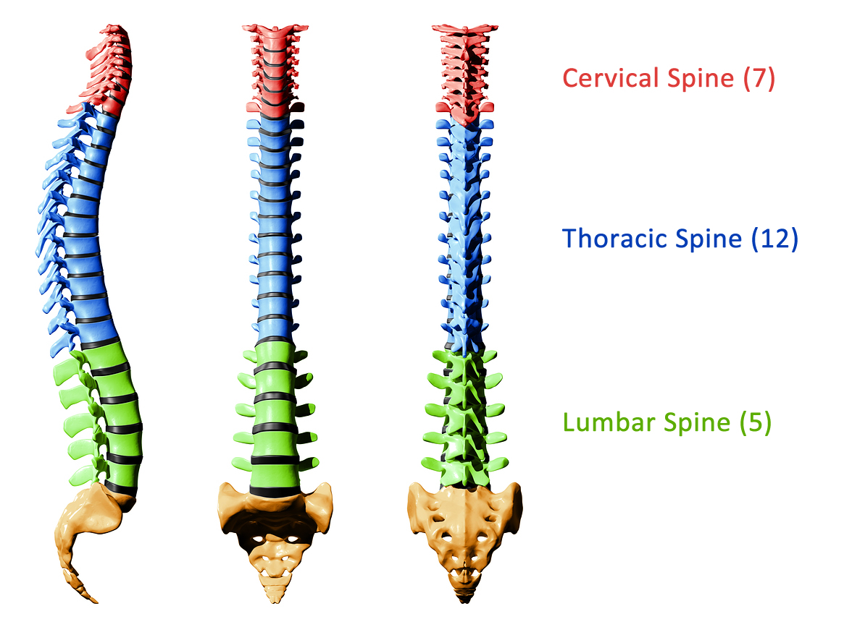
The Spine
Notes:
The spine is our body's central support structure. It keeps us upright and connects the different parts of our skeleton to each other.
It is a strong yet flexible structure that protects the spinal cord, supports the head, provides the ability to negotiate our environment, and that provides an attachment for the ribs.
Discuss areas of the spine.
Ask delegates which area they think may see the most injuries, and why.
(Lumbar Spine, i.e. lower back pain – due to leverage effect, limited flexibility at base of spine, exacerbated by twisting!).

Slide 13
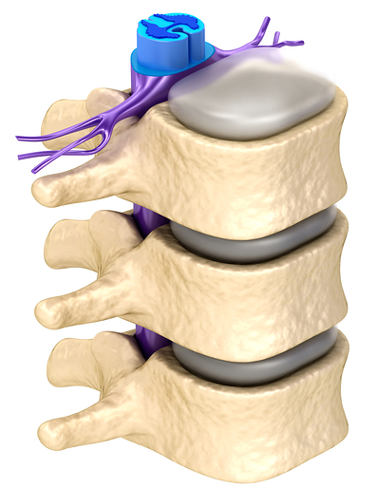
Spinal Discs
The spinal cord runs along the back of the discs, in a tunnel created by a hole in each vertebrae.
Vertabrae are interlocking bones, stacked one on top of the other, with the largest at the base.
Nerves branch off the spinal cord through a gap between successive Vertebrae.
Discs are strong, flexible structures sandwiched between each pair of
Vertebrae.
Notes:
Discuss the spine in detail.
Sandwiched between the vertebrae are the discs. The main functions of the intervertebral discs are:
to provide shock absorption
to provide flexibility of the spine.
Spinal discs act like cushions; damping the forces produced when walking, jumping, sitting, etc. Discs are so firmly adhered to the vertebrae above and below that they do not simply “slip”. A ‘leaking disc’ would be slightly more accurate way of describing what medical professionals call a ‘prolapsed disc’.
A pinched nerve occurs when too much pressure is applied to a nerve by surrounding tissues, such as bones, cartilage, muscles or tendons. ... A herniated disk in your lower spine, for example, may put pressure on a nerve root, causing pain that radiates down the back of your leg.

Slide 14
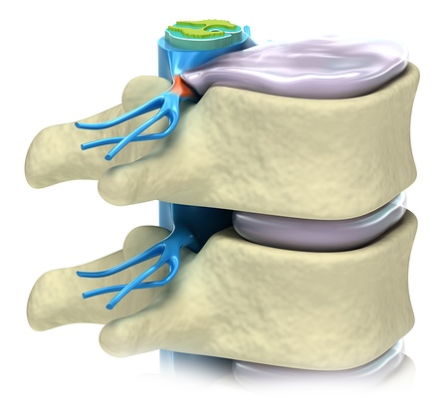
Spinal Discs
Nucleus pulposus
Spinal cord
Annulus fibrosus
Intervertebral
disc
Spinal nerves
Vertebrae
Notes:
Nerves
The spine encloses and protects the spinal cord which runs down the spinal canal from the brain. Nerves arise from the spinal cord and pass out between each pair of vertebrae. Once they have left the spine, the nerves branch out and supply all the tissues in their area, particularly the muscles. They also receive information from the joints, skin, tendons and muscles.
The nervous system is made up of millions of nerve fibres which transmit electrical impulses to and from the brain, connecting it with the rest of the body. When the nerve is irritated the effects can be felt along the length of the nerve. In cases in the low back, this can be all the way down to the foot and is known as Sciatica. In the neck irritated nerves can cause symptoms in the arm or hand.

Slide 15
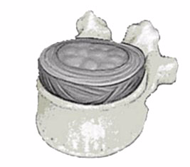
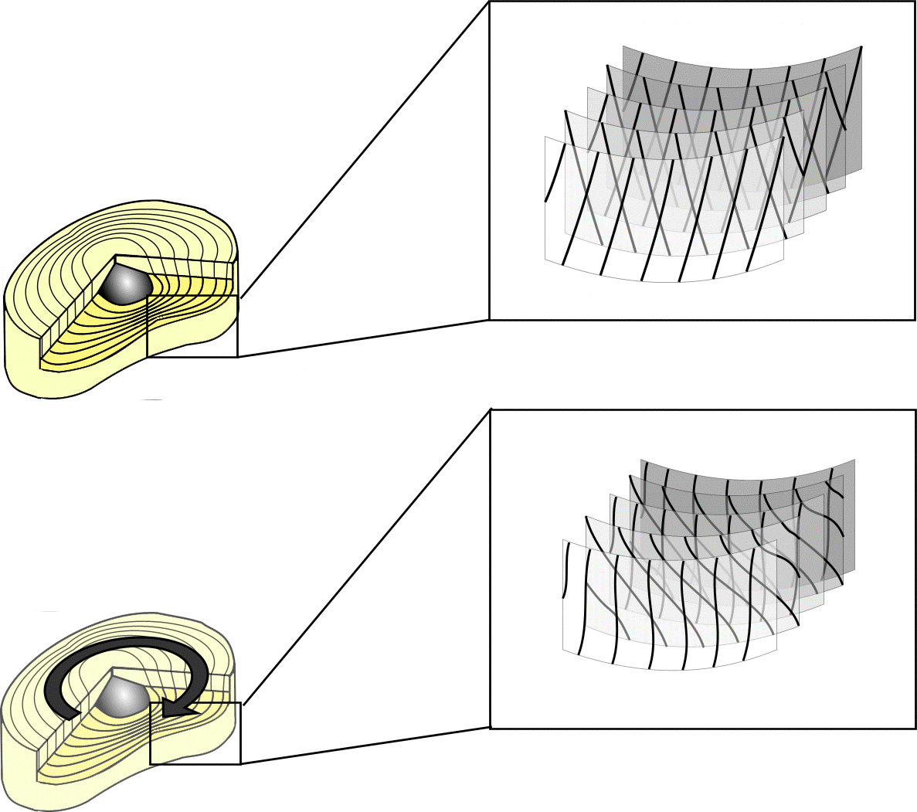
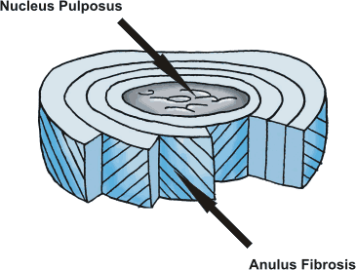
Spinal Anatomy in detail
Normal
Twisted
Notes:
Discs rarely get damaged by a single action but are more commonly susceptible to stresses caused by twisting and stooping actions. You can relate this back to cumulative strain discussed earlier in the session.
Tiny microscopic tears appear in the fibres of cartilage which on their own are very insignificant, but when many of these tears build up over several years, it can create cracks which allow the gel-like nucleus to leak through.
This can progress over time without us feeling pain or discomfort, due to the lack of nerves in the inner fibres of the disc.
If these tears continue, they will cause further weakening of the disc, which can allow the nucleus to migrate out from the disc structure possibly onto a spinal nerve. This is referred to as a disc prolapse or slipped disc.

Slide 16
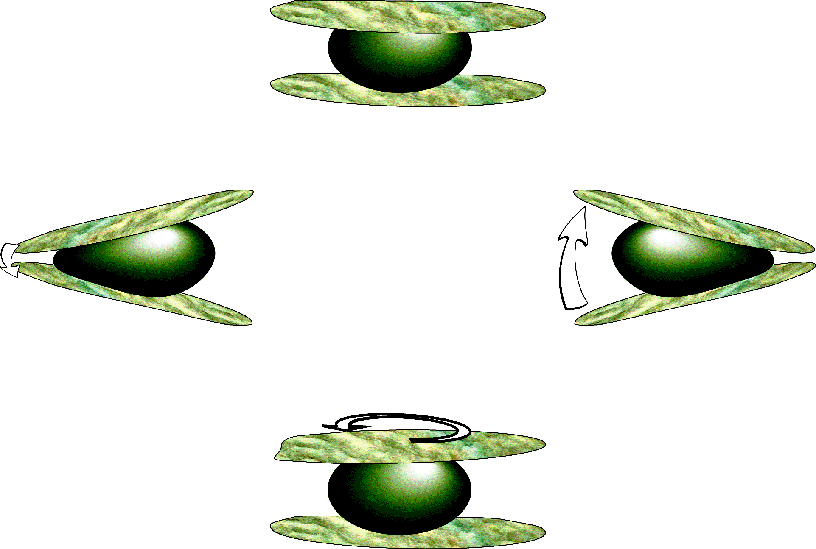
The Disc In Action
Bend
Bend
Twist
Notes:
16
The spine is very flexible, and can support a massive amount of load (weight).
It is very strong, and does take a lot of abuse - but there is only so much that it can take!

Slide 17
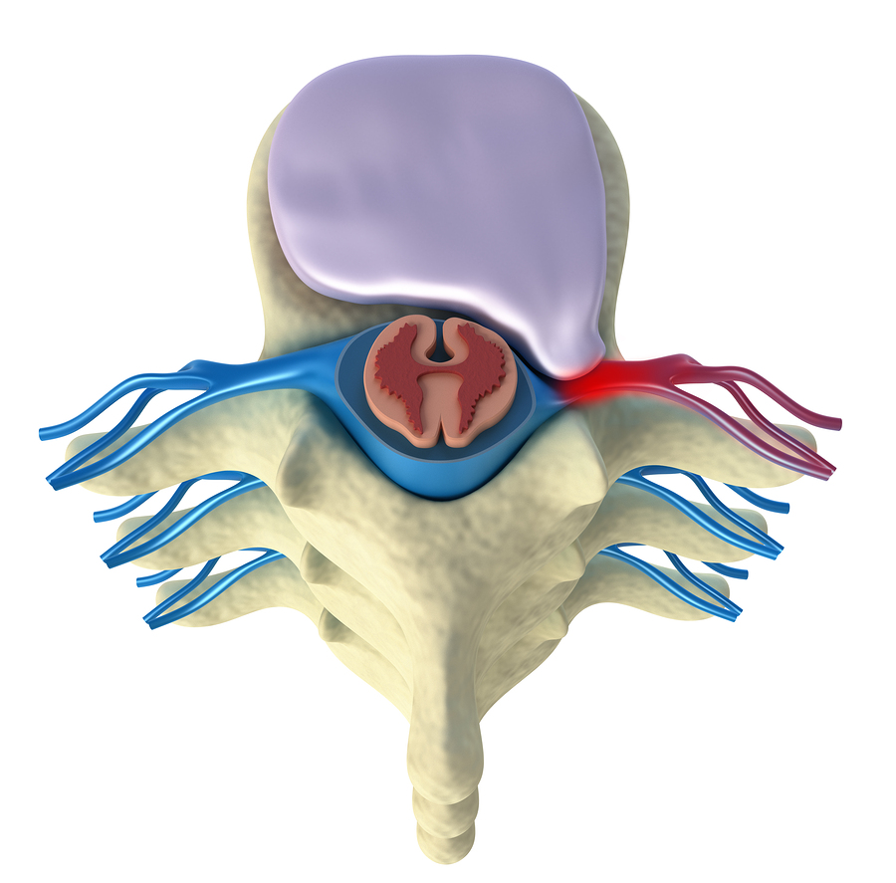
Prolapsed Disc
Notes:
17
When you have a prolapsed disc (commonly called a slipped disc), a disc does not actually slip!
What happens is that part of the inner softer part of the disc (the nucleus pulposus) bulges out (herniates) through a weakness in the outer part of the disc.
A prolapsed disc is sometimes called a herniated disc.

Slide 18
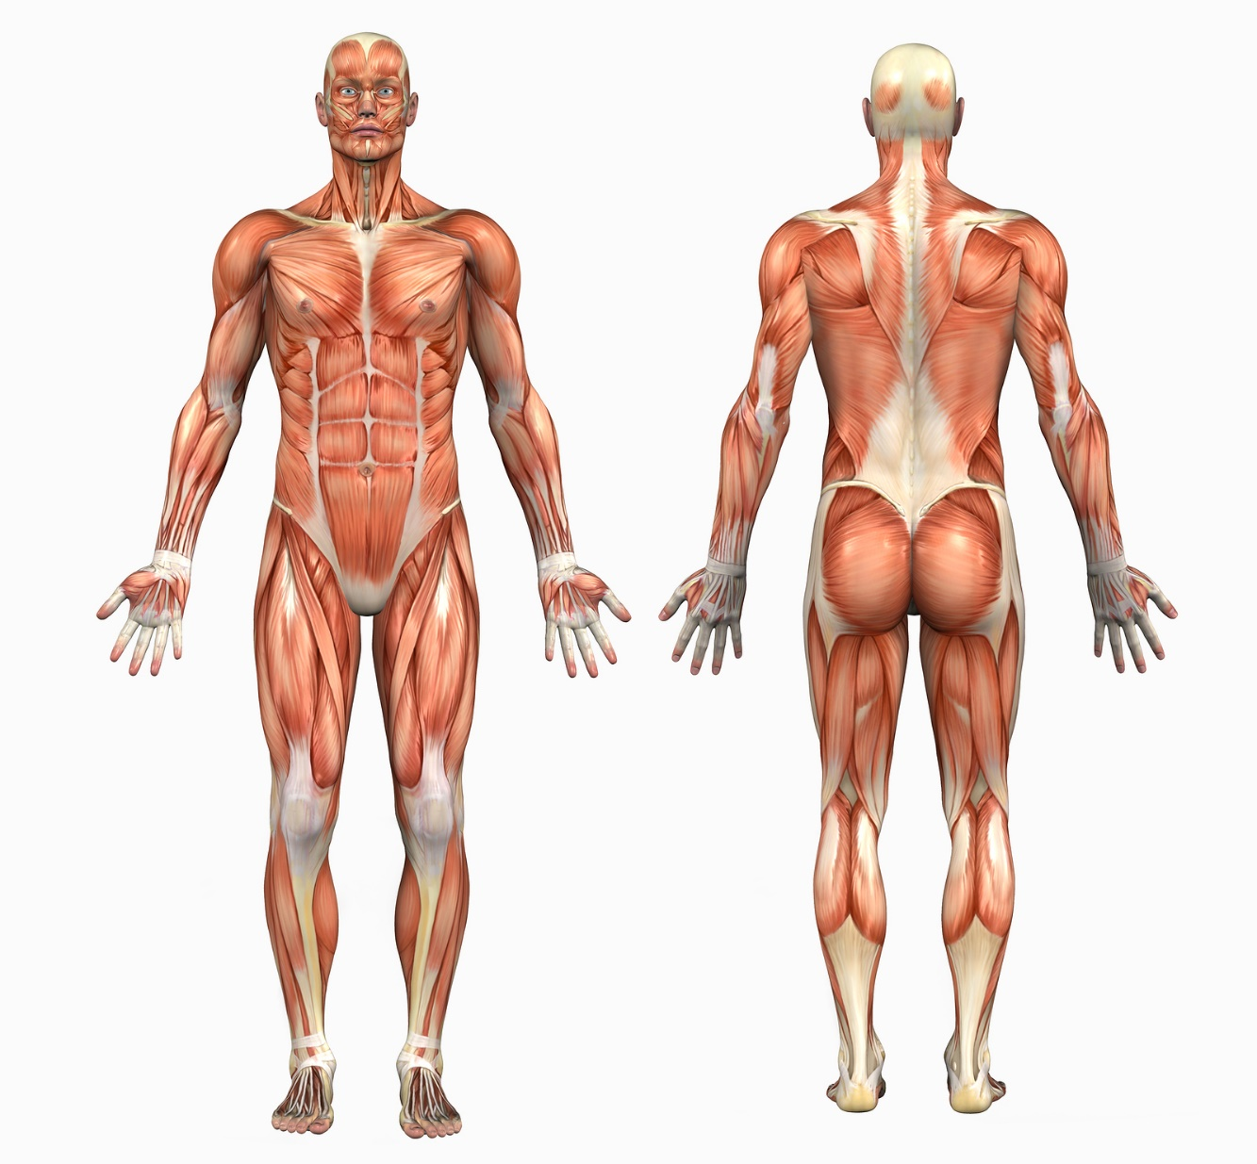
Muscles
Notes:
Muscle is a soft tissue found in most animals. Muscle cells contain protein filaments of actin and myosin that slide past one another, producing a contraction that changes both the length and the shape of the cell. Muscles function to produce force and motion.
Ligaments and tendons are fibrous bands of connective tissue.
Ligaments connect two or more bones together and help stabilize joints.
Tendons attach muscle to bone. Tendons may also attach muscles to structures, such as the eyeball.
Sprains and Strains:
The difference between a sprain and a strain is that a sprain injures the bands of tissue that connect two bones together, while a strain involves an injury to a muscle or to the band of tissue that attaches a muscle to a bone.

Slide 19
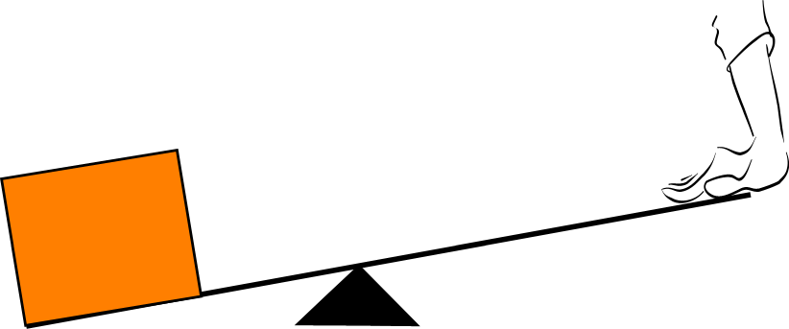
The Leverage Effect
Your lever arm
Load’s lever arm
Fulcrum
Notes:
The operation of most skeletal muscles involves leverage – using a lever to move an object.
Muscles and bones act together to form levers. A lever is a rigid rod (usually a length of bone) that turns about a pivot (usually a joint). Levers can be used so that a small force can move a much bigger force. This is called mechanical advantage.

Slide 20
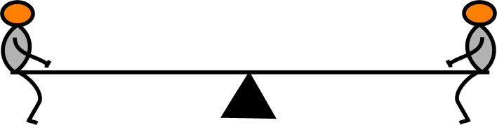
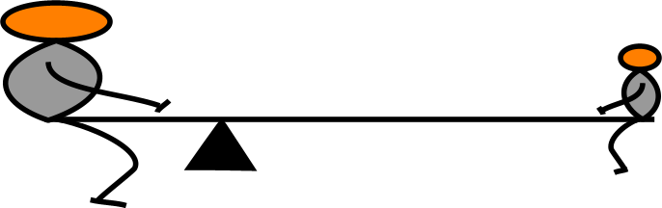
The Leverage Effect
Notes:
A lever amplifies an input force to provide a greater output force, which is said to provide leverage. The ratio of the output force to the input force is the mechanical advantage of the lever.

Slide 21
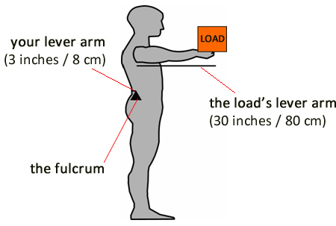
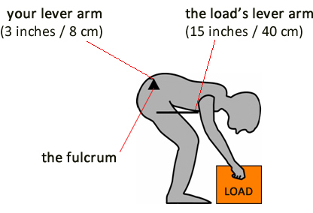
The Leverage Effect
30 inches
3 inches
Disadvantage: 10 to 1
Disadvantage: 5 to 1
and ⅔ of bodyweight
Notes:
When most people lift an object off the floor, they (unsafely!) use a top-heavy movement which involves stooping.
It is important to understand the mechanisms of injuries if we want to avoid damage to the musculoskeletal system. Most of us probably understand that if we lift something that is too heavy, we are at risk of exceeding the strength of our tissues and injury may result. However, you must bear in mind that the load does not have to be heavy.
We often do not appreciate the fact that our own body weight and/or the positions we adopt may also compromise the strength of our muscles, e.g. think about the risk of overstretching when lifting the shopping out of the boot of your car. In this case it is not uncommon to suffer an over-exertion injury in the lower back due to the leverage involved, as well as the physical insufficiency of the over-stretched muscles.
When lifting an object using this stooping technique, we must also consider the weight of your torso, arms and head - that is also a load that must also be lifted, along with the load that you are trying to pick up. This additional upper body weight may be 50kg (8 stone) for an average person.

Slide 22
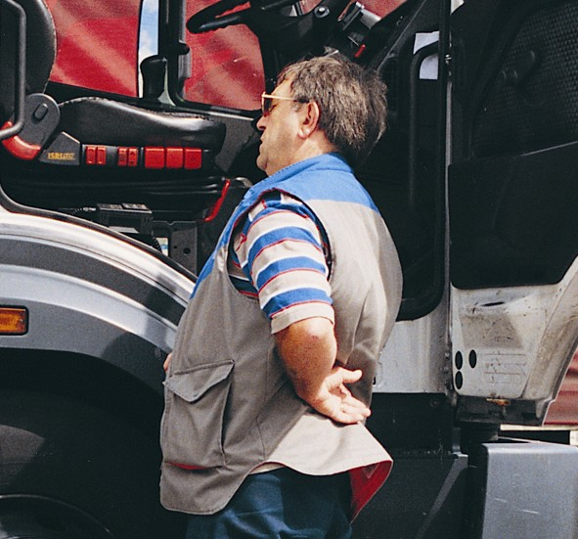
Causes of Back Pain
Genetic Make-up
Disease
Age
Gender
Lifestyle
Leisure
Work
Environment
Training
Exertion Injuries
Accidents
Psychological Factors
Notes:
Back pain….
tends to get better or worse depending on your position – for example, it may feel better when sitting or lying down
often feels worse when moving – but it's not a good idea to avoid moving your back completely, as this can make things worse
can develop suddenly or gradually
is sometimes the result of poor posture or lifting something awkwardly
Low back pain can be caused by an injury, like a muscle sprain, or an underlying condition, like sciatica.

Slide 23
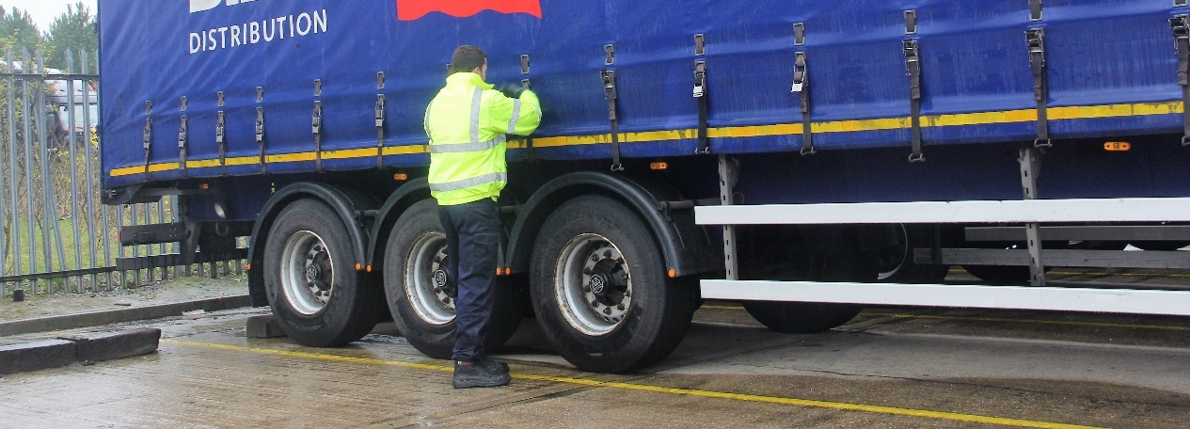
Categories of Assessment
Task
Individual
Load
Environment
PPE/Equipment
Work organisation/psychosocial
Notes:
TILE is an acronym that aims to help you carry out a manual handling risk assessment. TILE prompts you to consider each essential area of the activity in order to improve health and safety. In terms of manual handling, the TILE acronym stands for Task, Individual, Load, and Environment:
T – Task. This means considering the manual handling activity itself, i.e. the lifting, lowering, carrying, pushing or pulling, and looking at how it may affect your health and safety. For example, does the task involve repetitive movements, strenuous movements, long distances, or uneven weight distribution?
I – Individual. This means considering the person who will be carrying out the manual handling activity, i.e. you or another colleague. For example, how strong, fit or able is the person? Are they capable of manual handling alone? Do they need assistance?
L – Load. This means considering the object or person that is being moved, and looking at how this may affect health and safety. For example, is the load particularly heavy, bulky, hard to grasp or unstable?
E – Environment. This means considering the area in which the load is being moved, and looking at how this could make the manual handling task unsafe. For example, are there any space constraints? Is the floor slippery or uneven? Is there sufficient lighting? Are there any trip hazards?

Slide 24
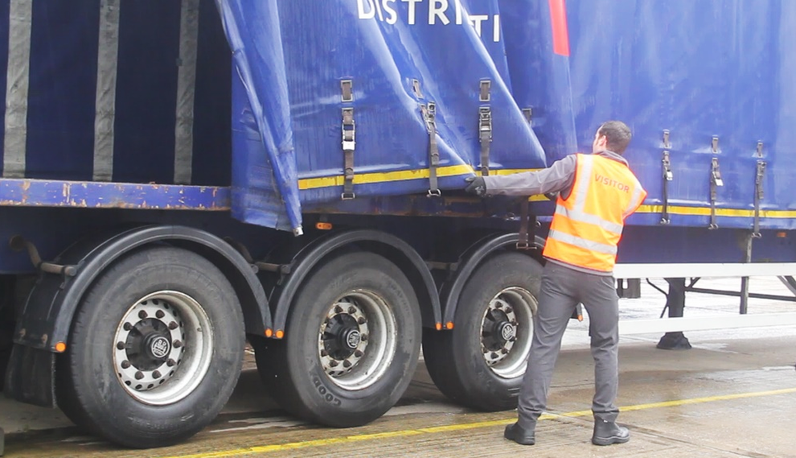
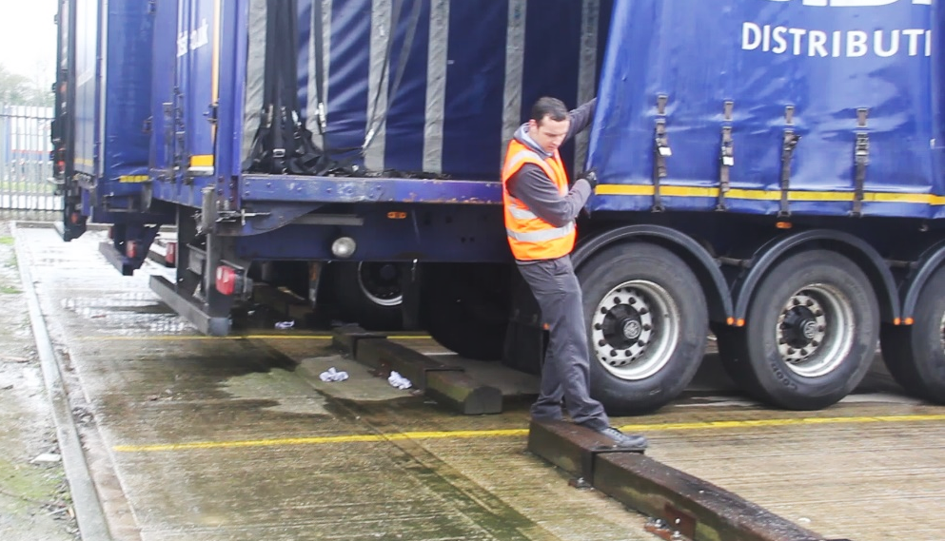
Risk Assessment Scenario
Is this the correct procedure?
Notes:
Picture 2: trip hazard.

Slide 25
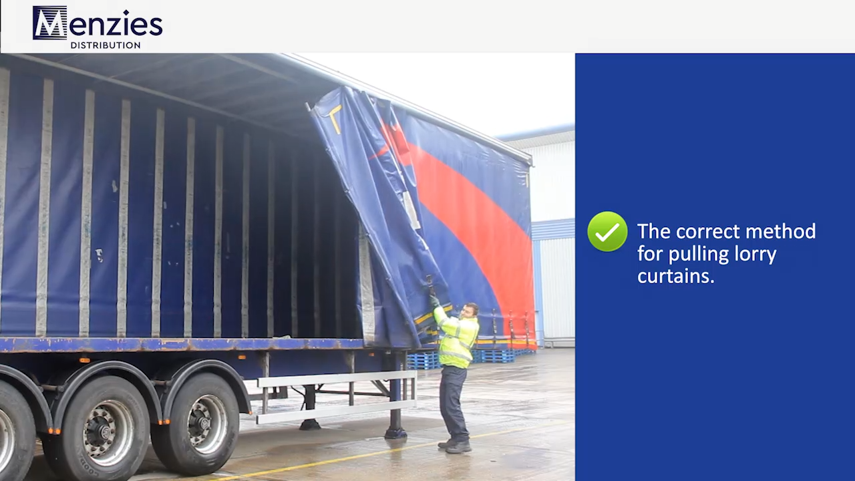
VIDEO – Wagon curtains
Notes:
Watch the video and discuss with your delegates.

Slide 26
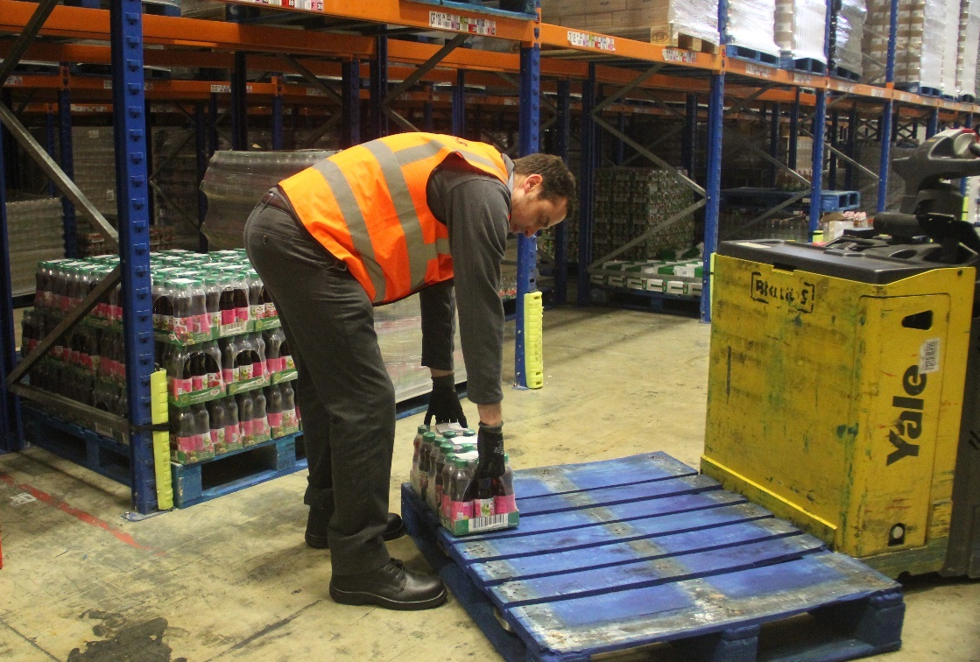
S.T.O.P.
Stoop
Twist
Over Stretch
Parallel Hands and Feet
Notes:
Your delegates may understand that over-stretching and then loading a muscle may increase the chance of a muscle strain through over exertion.
The classic ‘unsafe’ approach – top heavy movement
The term ‘top heavy movement’ describes the classic movement pattern people generally use when lifting objects.
The key points of top heavy movement are:
Stoop
Twist
Over-stretch
Parallel hands and feet.
STOP is an acronym to help them remember the poor postures that can lead to a musculoskeletal injury.

Slide 27
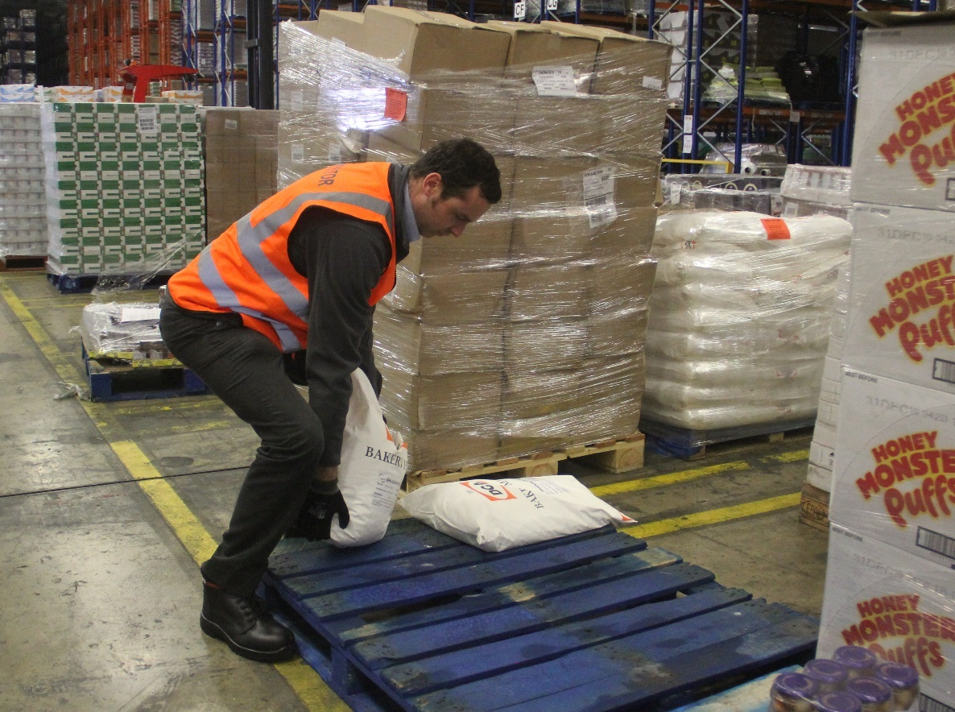
Practical - Semi Squat Lift
Assess
Feet
Knees
Hips/Back
Head and neck
Grip
Load close.
Notes:
27
Your delegates may understand that over-stretching and then loading a muscle may increase the chance of a muscle strain through over exertion. If you relate this to the scenario which may occur if you assume a stooped posture (‘bad’ lifting posture), then you can imagine that your calf muscles, hamstrings, and low back muscles are all in a stretched position and the larger quadriceps, gluts and core muscles are not being utilised.
If you use the semi-squat lifting technique you will drastically reduce the loading on your lower back, and instead put that strain through your more powerful legs and core muscles. If you relate this to the leverage effect we looked at earlier, it’s a no-brainer. A ‘stoop posture’ has a long lever with small lower back muscles, whereas a semi-squat posture uses a short lever with the more powerful leg and core muscles.

Slide 28
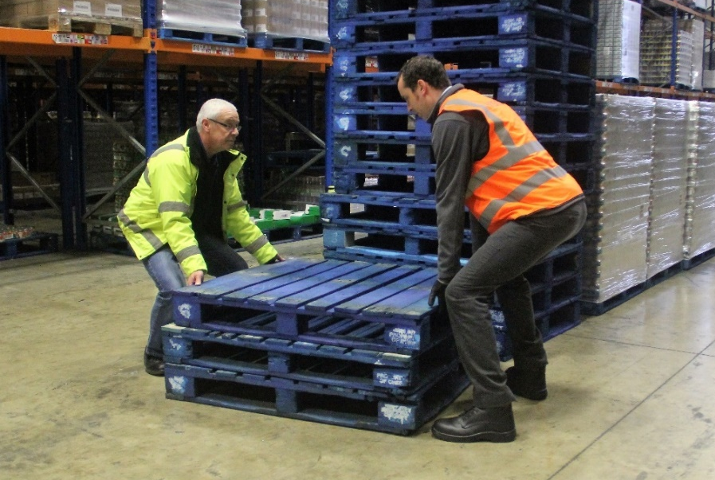
Team Lifting
Assess
Perform a quick T.I.L.E. assessment
Capabilities
Clear route
Communication
Nominate a leader
Clear commands
Everybody ready?
Is everyone capable?
How do capabilities compare? Height, strength, etc.
Does everyone know the route?
Is the route clear?
Consider how you will grip/lift the item
Notes:
Firstly, is the load even suitable for team lifting? Could manual handling assistance equipment be used instead?
Use this slide to talk through the points stated below.
First of all, in order to avoid placing an uneven load on one person, make sure that:
the members of your team are of similar height, build and strength.
You then need to:
nominate a team leader, who will issue the command to lift
make sure that everyone understands the technique
specify that lifting will occur on the word ‘Lift’ in the command “Ready, Steady, Lift”
ensure everyone is clear about what happens once they are standing up, i.e. in which direction to move, where the load needs to go, how to put it down again, etc.
Once the technique has been discussed, all members of the team should:
take up positions evenly spaced around the load
adopt an asymmetric stance
squat down using dynamic handling, with the back straight and your head upright
grip the load securely, using the asymmetric grip wherever possible.
Your team is now ready to lift. On the command “Ready, Steady, Lift” from the team leader, everyone should:
stand up using dynamic handling
continue as arranged before the lift.
To set the load down again:
the team leader issues the command “Ready, Steady, Down”
all members of the team lower themselves using dynamic handling, until the load is resting on its destination surface
once the load is safely in place, everyone can let go.

Slide 29
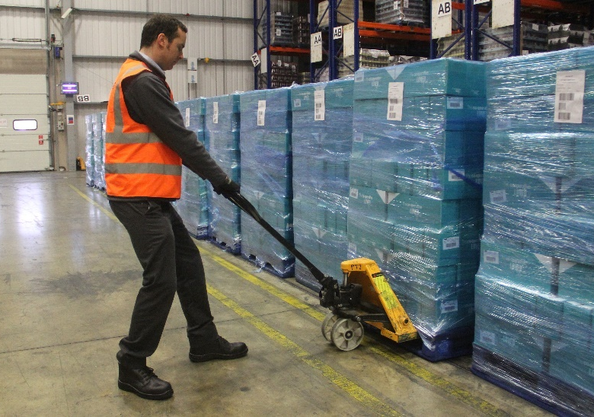
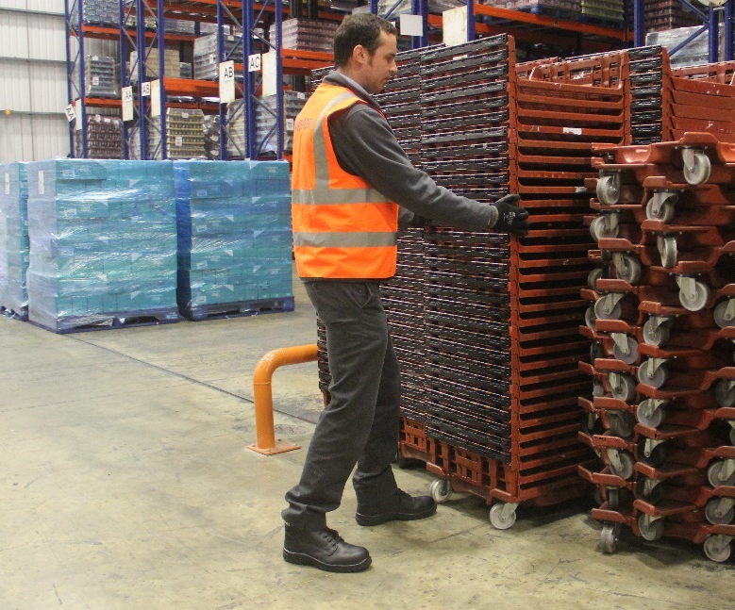
Pushing and Pulling
Assess (T.I.L.E.)
Asymmetrical stance
Lower centre of gravity
Power from the legs
Hips square on to the load
Keep spine straight
Notes:
In general, pushing a load is much more powerful than pulling, as your whole body is designed for forward movement. Therefore, when the situation allows, you should always opt to push rather than pull a load.
Discuss classic inefficient techniques
As with the lifting techniques, most people use less-safe techniques when they push and pull. These are inefficient and put your back at risk.
place their feet wide apart, with one foot in front of the body and the other at an angle out to the side
bend their body down and forwards, often to an almost horizontal position
stretch out their arms and place them on the load
use their entire body to propel the weight forward.
Correct techniques
The key points of the safer techniques are to:
use your powerful leg muscles to maximise power
apply the force directly from your legs to the load
keep your back in its neutral position to place it under minimal risk.
You should note that:
wearing shoes with a high- grip sole helps you to maintain a safe and solid stance
using gloves can improve your grip, especially when using a rope for pulling.

Slide 30
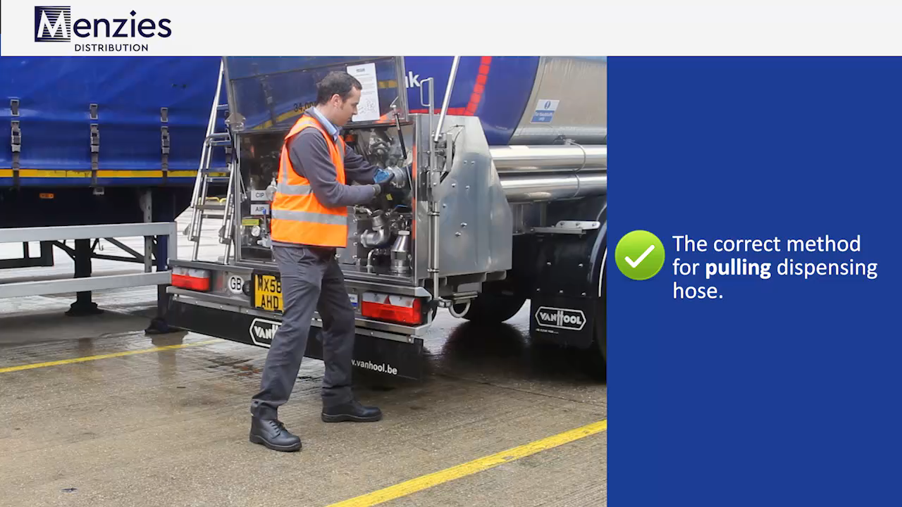
VIDEO – Dispensing hose
Notes:
Watch the video and discuss with your delegates.

Slide 31
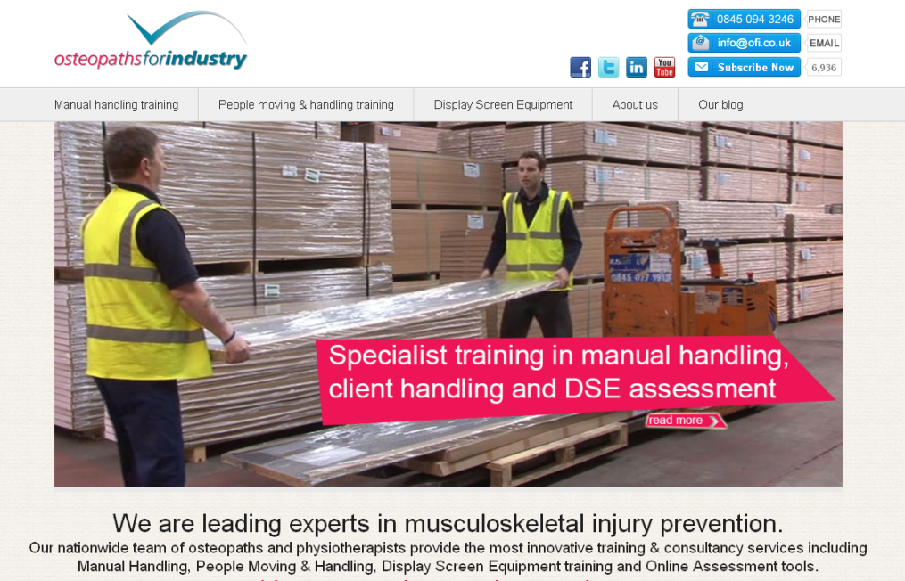
© Osteopaths For Industry Ltd.
All rights reserved. No part of this documentation may be reproduced or transmitted in any form or by any means, electronic or mechanical, including photocopying, scanning, recording, downloading or uploading on to a computer or any information storage or retrieval system without prior written permission of Osteopaths For Industry Ltd. Any unauthorised or restricted act in relation to this publication may result in civil proceedings and/or criminal prosecution.
Keep up to date
Visit us on the web
ofi.co.uk

